Slide 1
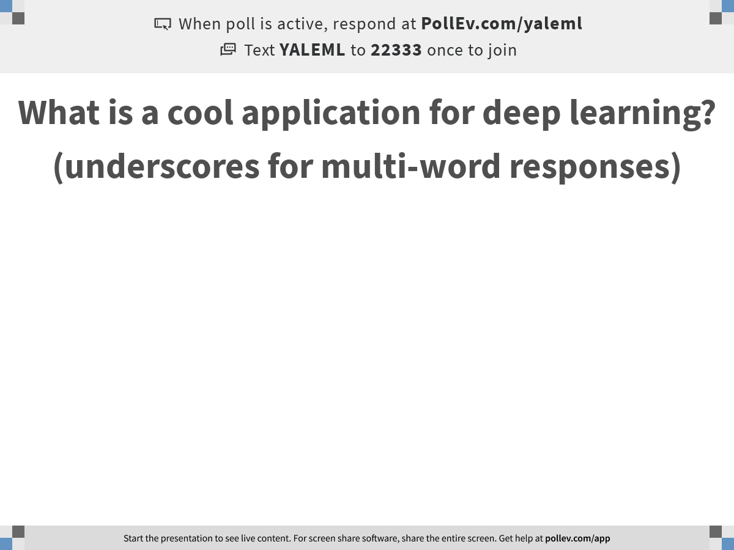
Notes:
What is a cool application for deep learning? (underscores for multi-word responses)
https://www.polleverywhere.com/free_text_polls/3qd7wqefwOqdnE8PrJqf5

Slide 2

Introduction to Deep Learning
Notes:
TA introduction
Talk about not teaching code (not a programming workshop)

Slide 3
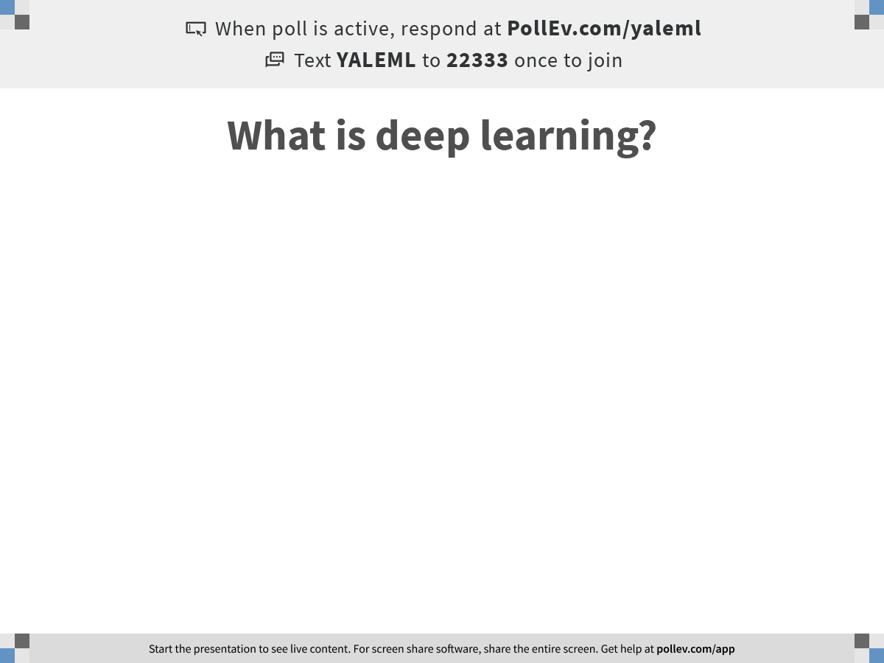
Notes:
What is deep learning?
https://www.polleverywhere.com/free_text_polls/n6Cd9E8zhpiOXcrSWg7aN

Slide 4
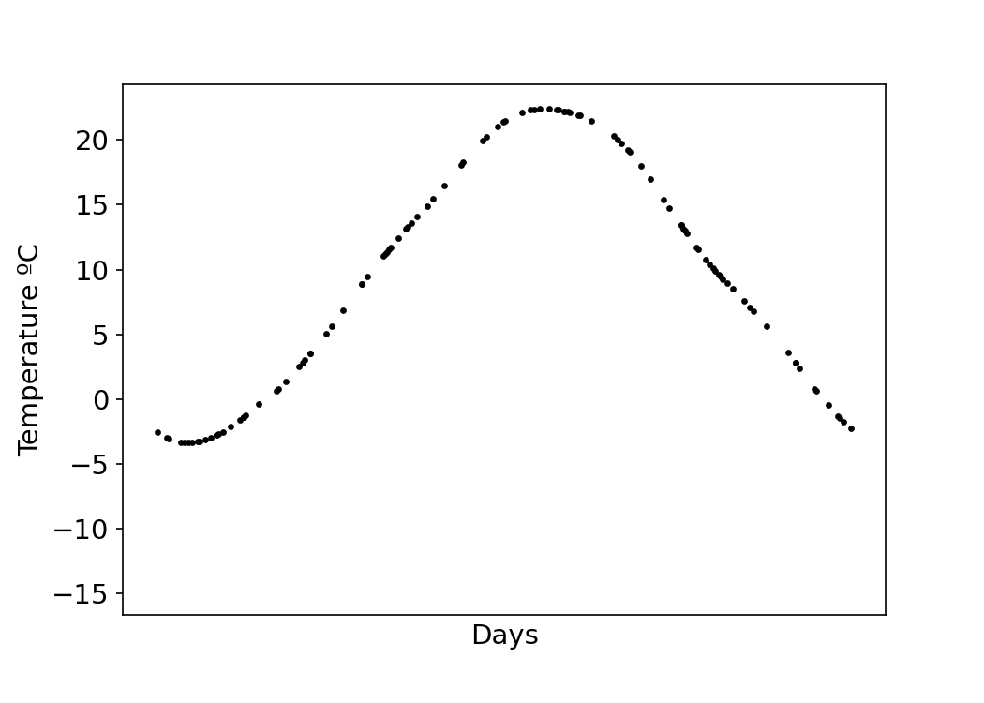
How can we predict unseen data?

Slide 5
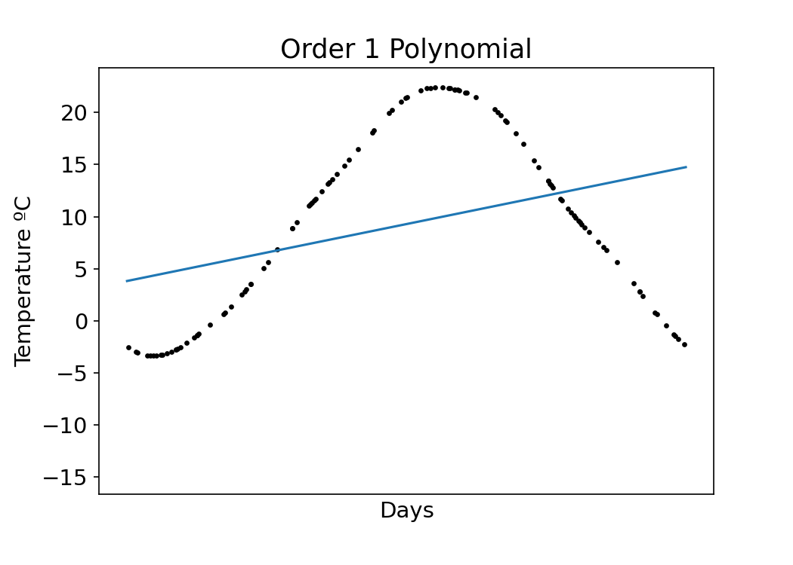
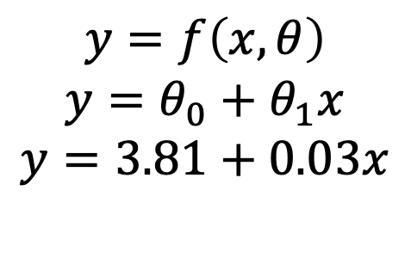
How can we predict unseen data?
$$y=f\left(x,θ\right)$$
$$y=θ_{0}+θ_{1}x$$
$$y=3.81+0.03x$$

Slide 6
How can we predict unseen data?
$$y=f\left(x,θ\right)$$
$$y=θ_{0}+θ_{1}x$$
$$y=3.81+0.03x$$
Bias
Weight

Slide 7
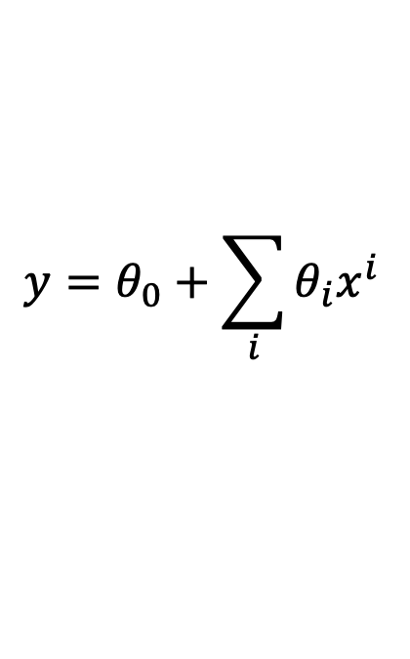
How can we predict unseen data?
$$y=f\left(x,θ\right)$$
$$y=θ_{0}+θ_{1}x$$
$$y=3.81+0.03x$$
$$y=θ_{0}+\sum_{i}{θ_{i}x^{i}}$$

Slide 8
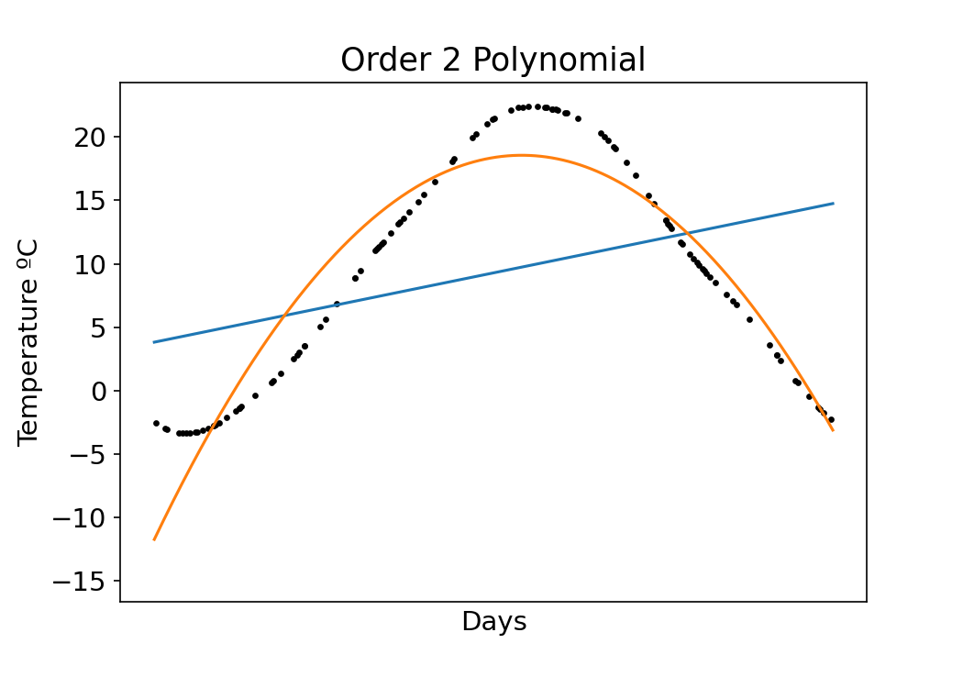
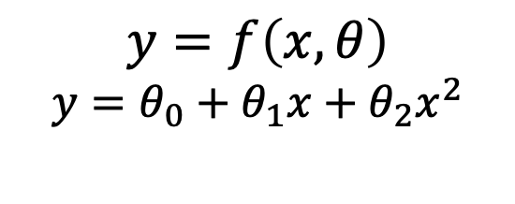
How can we predict unseen data?
$$y=f\left(x,θ\right)$$
$$y=θ_{0}+θ_{1}x+θ_{2}x^{2}$$

Slide 9
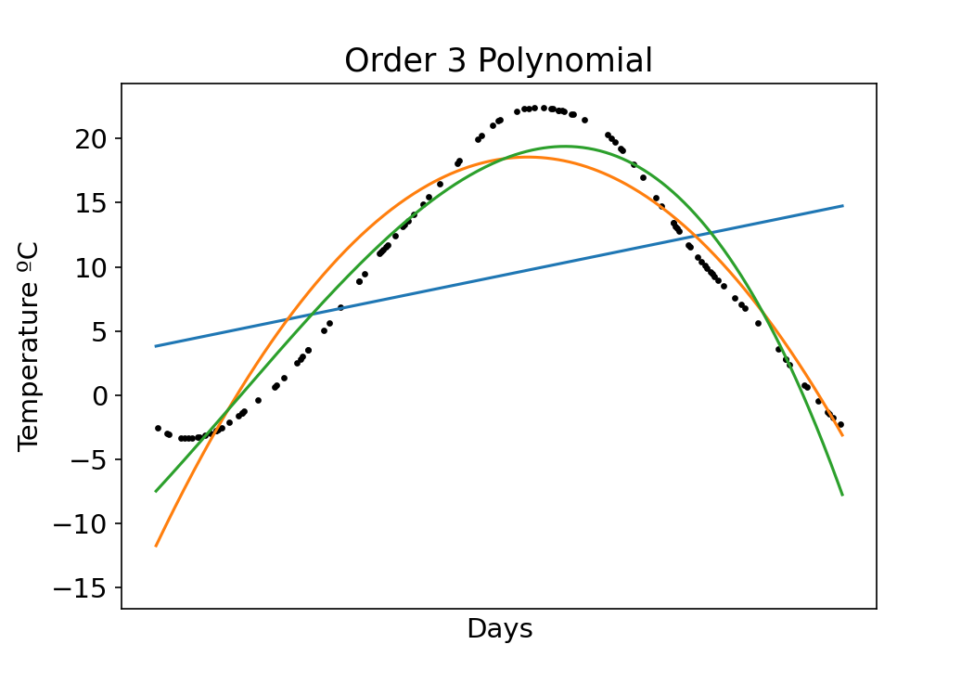
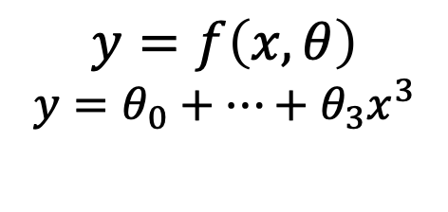
How can we predict unseen data?
$$y=f\left(x,θ\right)$$
$$y=θ_{0}+…+θ_{3}x^{3}$$

Slide 10
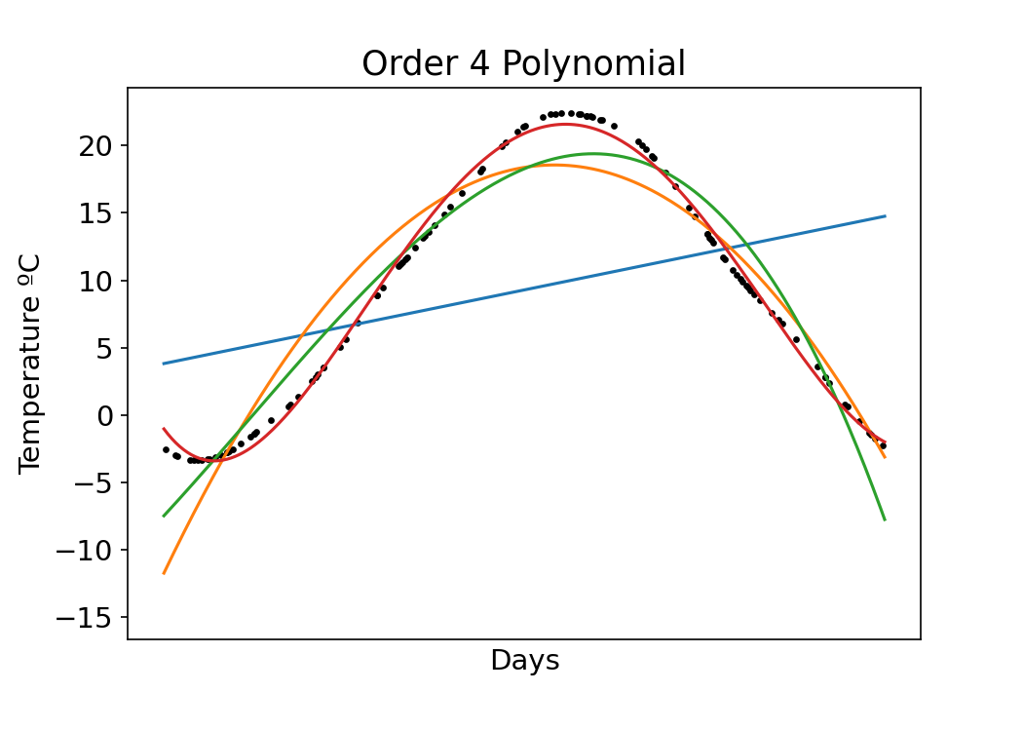
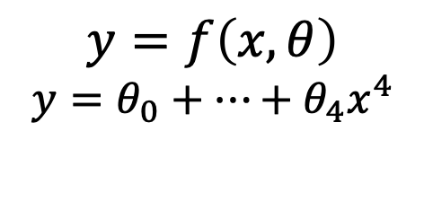
How can we predict unseen data?
$$y=f\left(x,θ\right)$$
$$y=θ_{0}+…+θ_{4}x^{4}$$

Slide 11
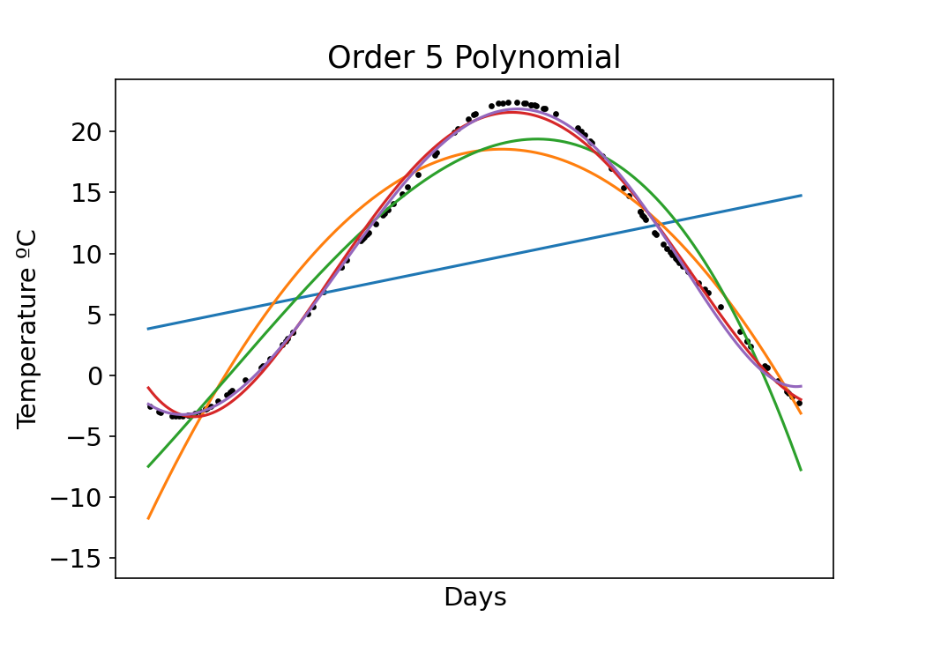
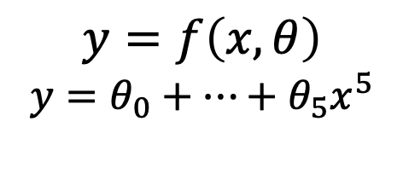
How can we predict unseen data?
$$y=f\left(x,θ\right)$$
$$y=θ_{0}+…+θ_{5}x^{5}$$
Increasing parameters improves model fit!

Slide 12
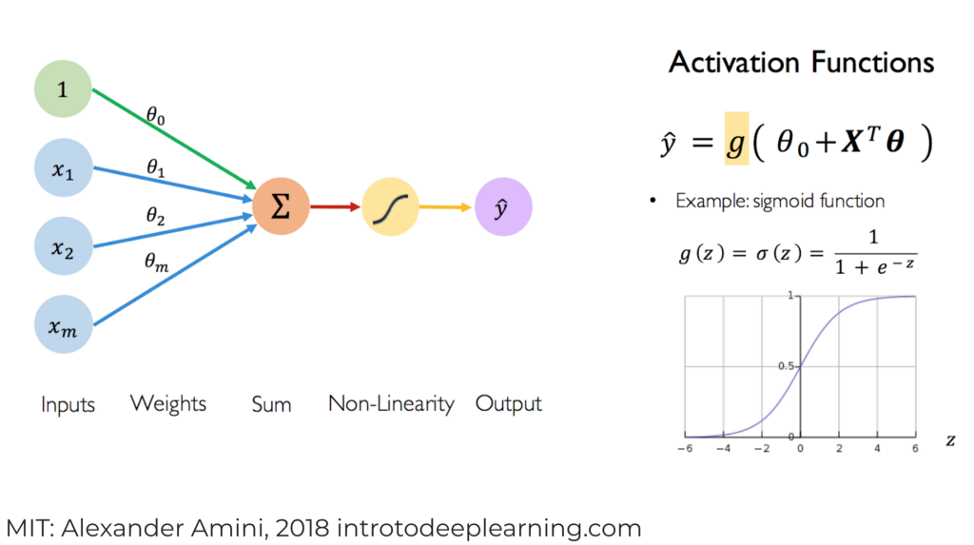
The heart of neural networks are weights and biases

Slide 13
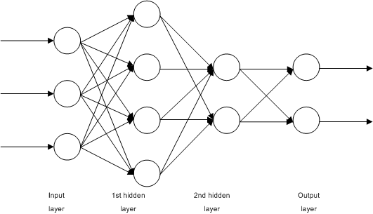
Nodes of a network are arranged in layers to form deep networks
WikiMedia

Slide 14
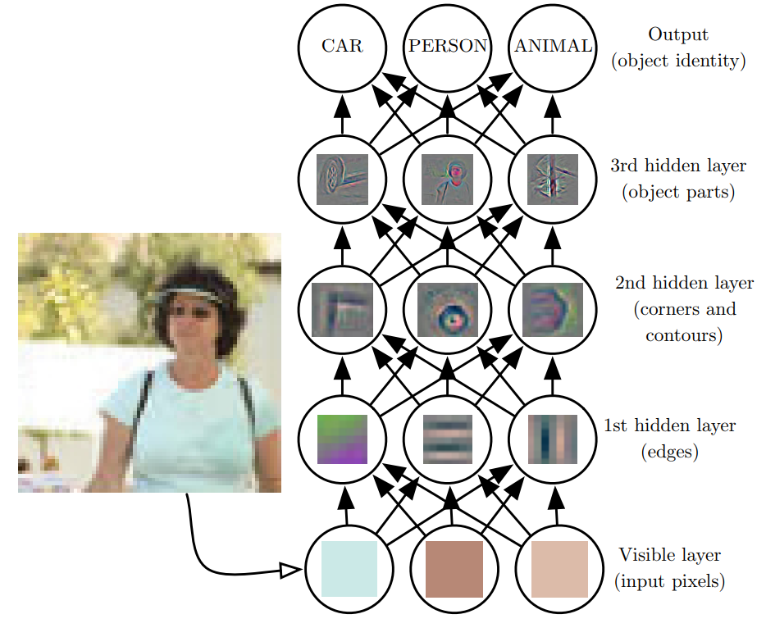
Network depth creates a composition of functions
Goodfellow et al., 2016
Notes:
Deep learning has the tendency to break the data down into different representations at different layers. Input is presented at the visible layer and the hidden layers extract increasingly abstract features which are then used, for example, to classify

Slide 15
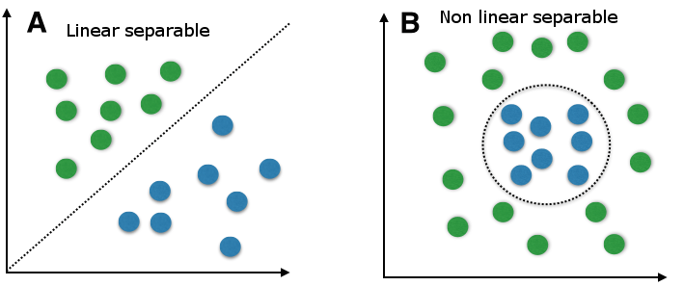
Why go deep?
Depth = complexity
Single layer perceptrons can only handle linear separability
Notes:
A major reason is that how the data is represented is important. On the left, if you were tasked with using a straight line to separate the two types of data, you would fail. On the right though, by simply transforming the data into a different coordinate system, it becomes very easy to do.

Slide 16
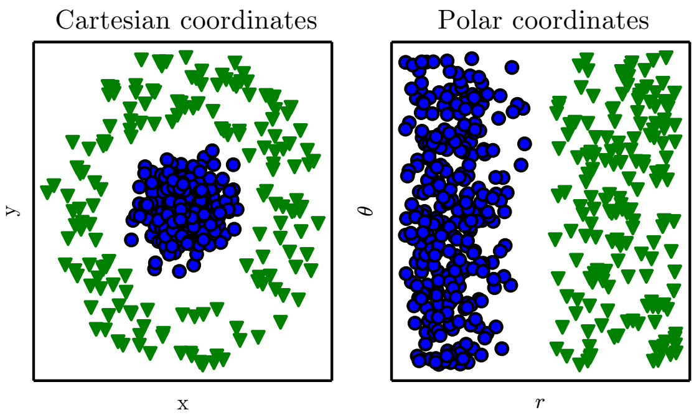
Representations matter
Goodfellow et al., 2016
Notes:
A major reason is that how the data is represented is important. On the left, if you were tasked with using a straight line to separate the two types of data, you would fail. On the right though, by simply transforming the data into a different coordinate system, it becomes very easy to do.

Slide 17
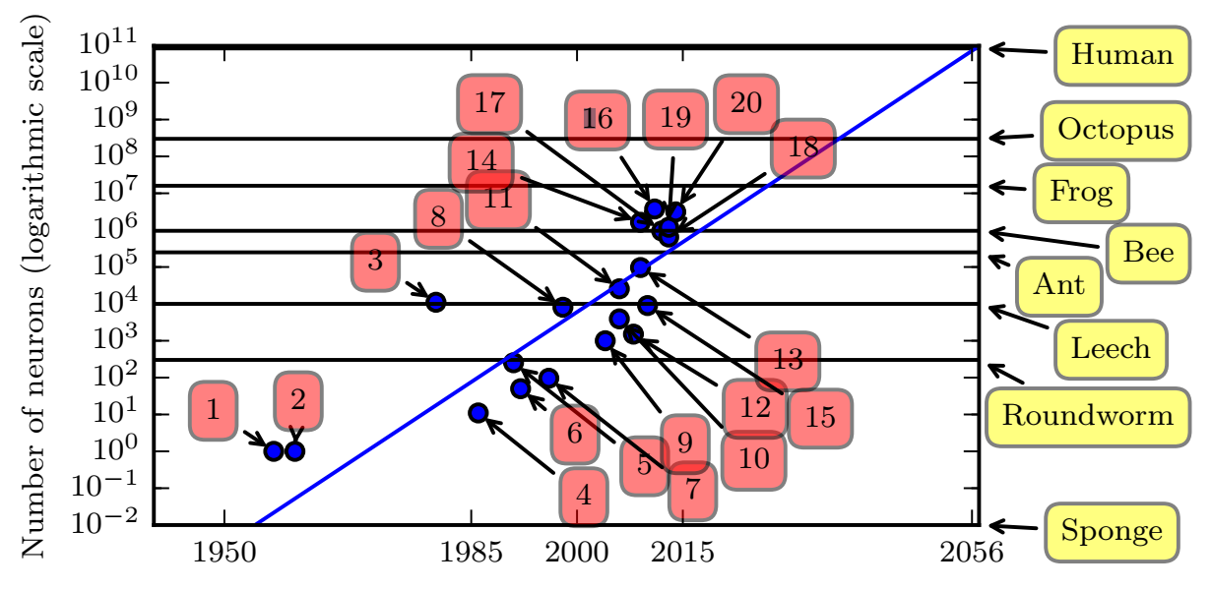
Increasing # of neurons
Goodfellow et al., 2016
1. Perceptron (Rosenblatt, 1958)
4. Early backpropagation network
6. MLP for speech recognition (Bengio et al, 1991)
11. GPU-accelerated convolutional network (Challeapilla et al., 2006)
20. GoogLeNet (Szegedy et al., 2014a)
Notes:
Neural network size is increasing over time. Note that we’re still below the level of a frog.

Slide 18
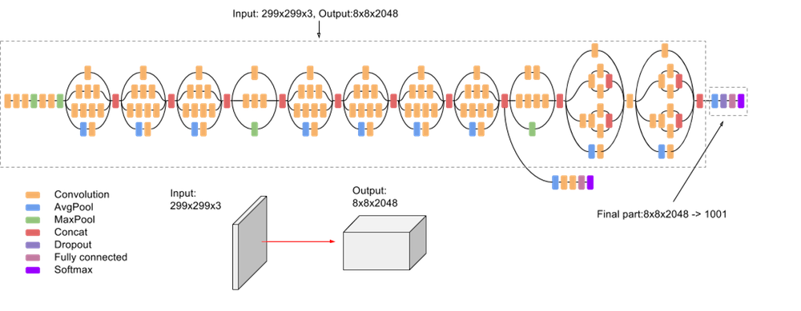
Layers can be arranged in arbitrary configurations to increase model power
Google’s Inception v3 Image Recognition network has 24M parameters!
Google

Slide 19
Layers can be arranged in arbitrary configurations to increase model power
What about overfitting?
Google’s Inception v3 Image Recognition network has 24M parameters!
Google

Slide 20
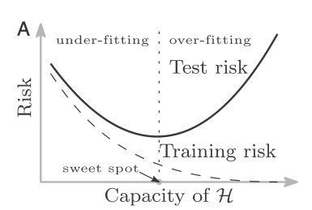
Classic risk curve
Belkin et al. PNAS (2019)

Slide 21
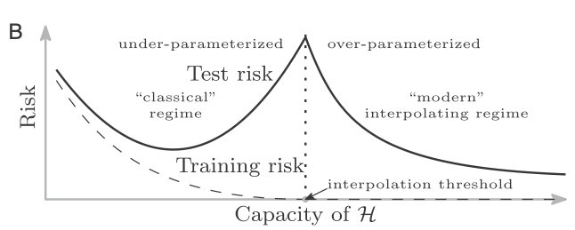
Double Descent
Belkin et al. PNAS (2019)

Slide 22
Double Descent
Belkin et al. PNAS (2019)

Slide 23
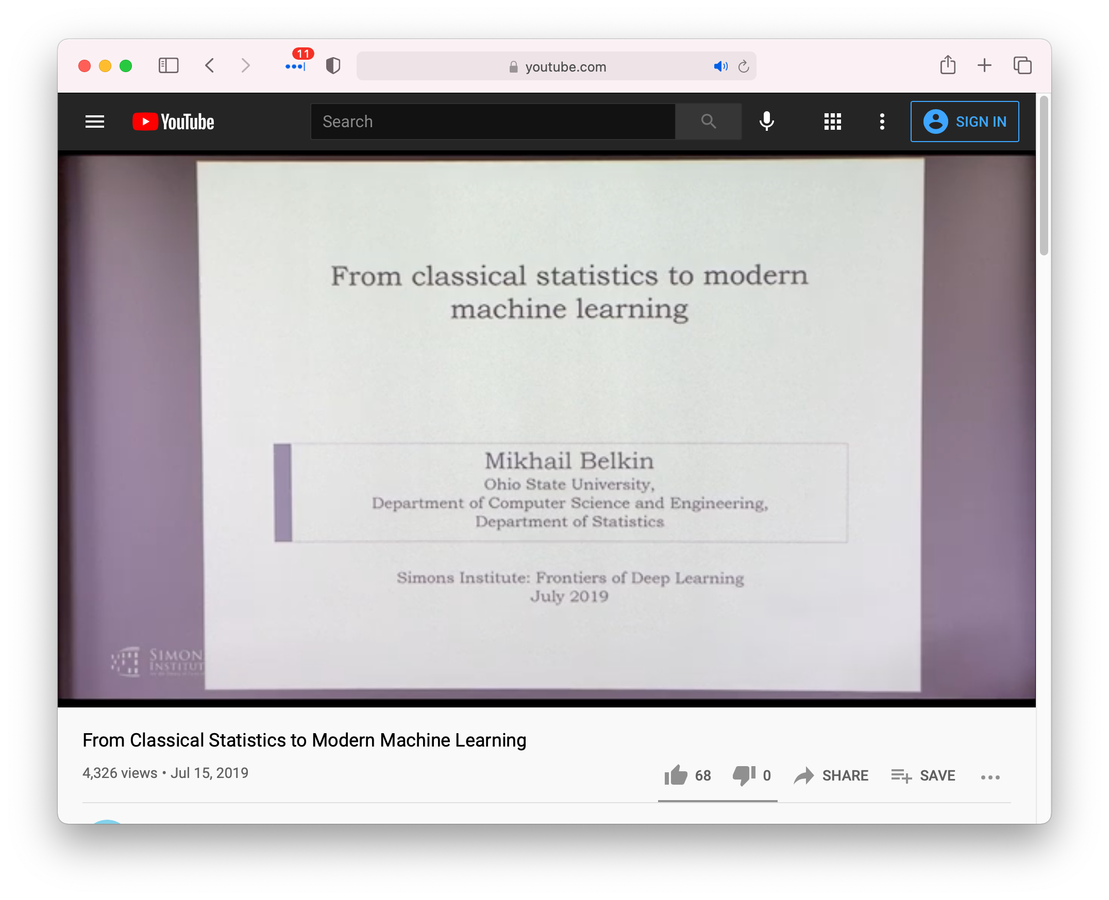
Double Descent
https://www.youtube.com/watch?v=OBCciGnOJVs&feature=youtu.be

Slide 24
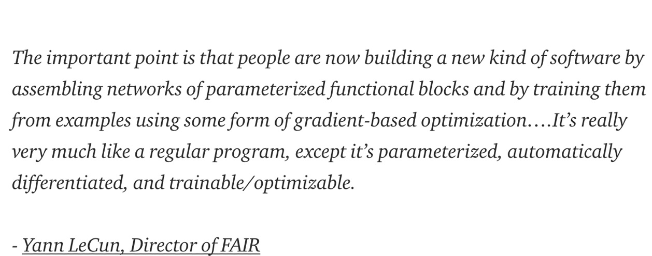
Differentiable Computing

Slide 25
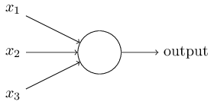
The perceptron
Developed in 1950’s and 1960’s by Frank Rosenblatt
Binary inputs
Single binary output
Example:
Nielsen, 2015
Notes:
In general could have more or fewer inputs.
Mention that figures come from Michael Nielsen’s book

Slide 26
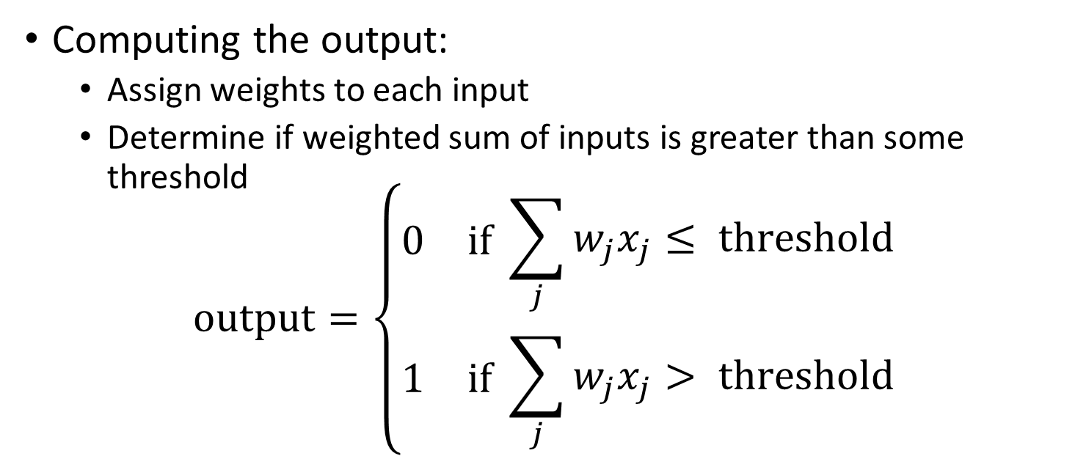
The perceptron
Nielsen, 2015
Computing the output:
Assign weights to each input
Determine if weighted sum of inputs is greater than some threshold
$$\text{output}=\left\{\begin{aligned}\begin{matrix}0 & \text{if} \end{matrix}\sum_{j}{w_{j}x_{j}}≤ \text{threshold} \\ \begin{matrix}1 & \text{if} \end{matrix}\sum_{j}{w_{j}x_{j}> \text{threshold}}\end{aligned}\right.$$

Slide 27
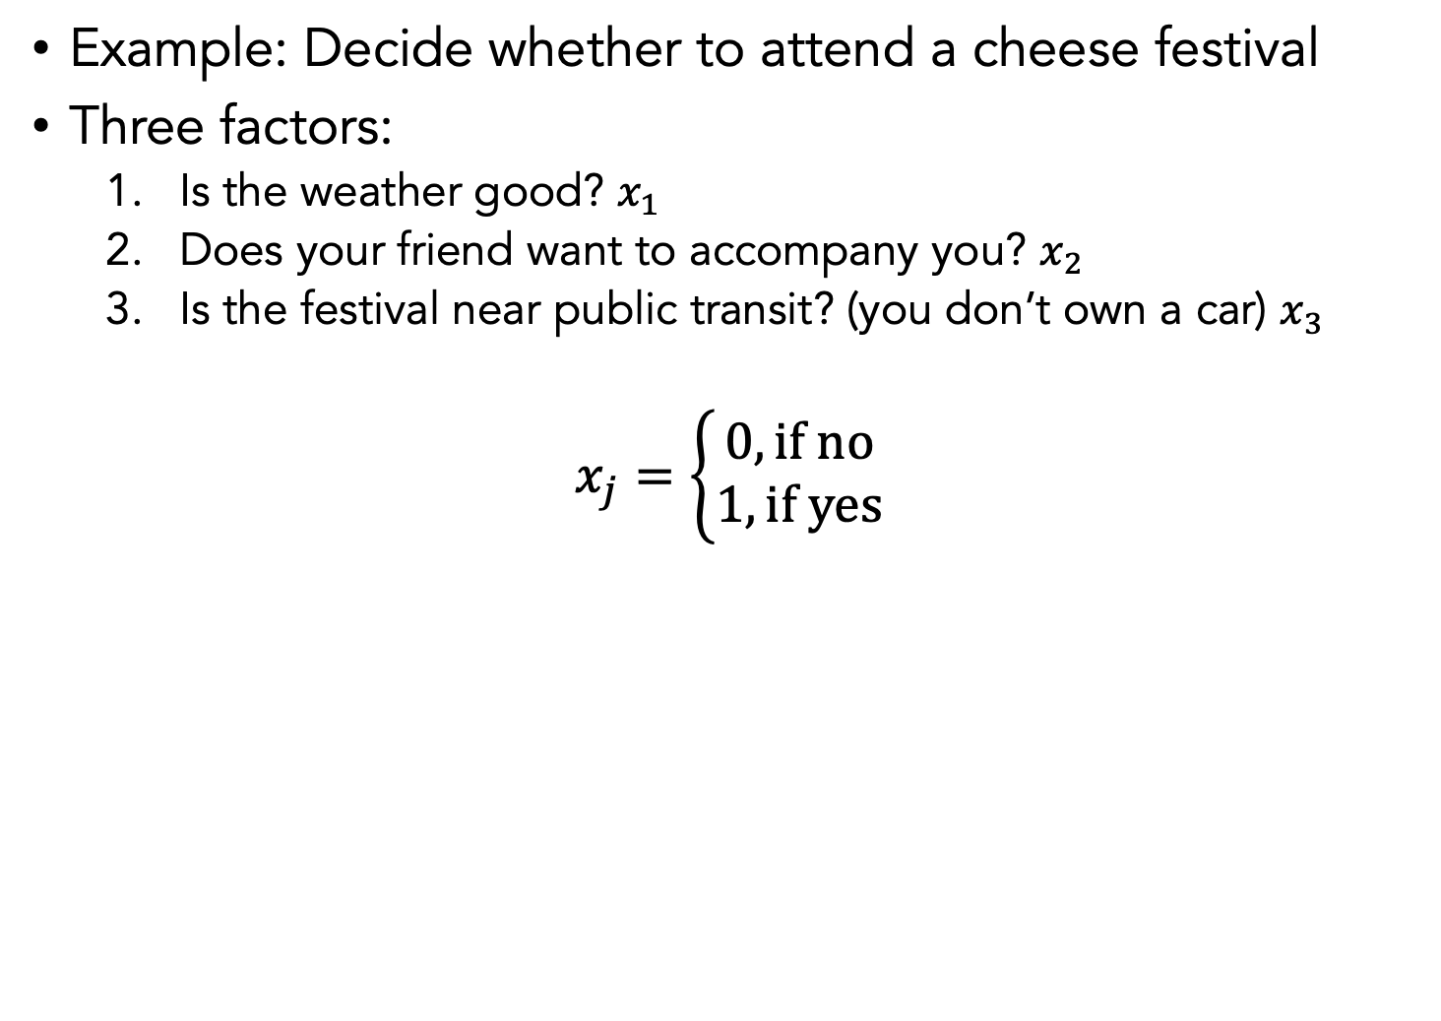
Nielsen, 2015
Example: Decide whether to attend a cheese festival
Three factors:
Is the weather good? $x_{1}$
Does your friend want to accompany you? $x_{2}$
Is the festival near public transit? (you don’t own a car) $x_{3}$
$$x_{j}=\left\{\begin{aligned}0, \text{if} \text{no} \\ 1, \text{if} \text{yes}\end{aligned}\right.$$

Slide 28
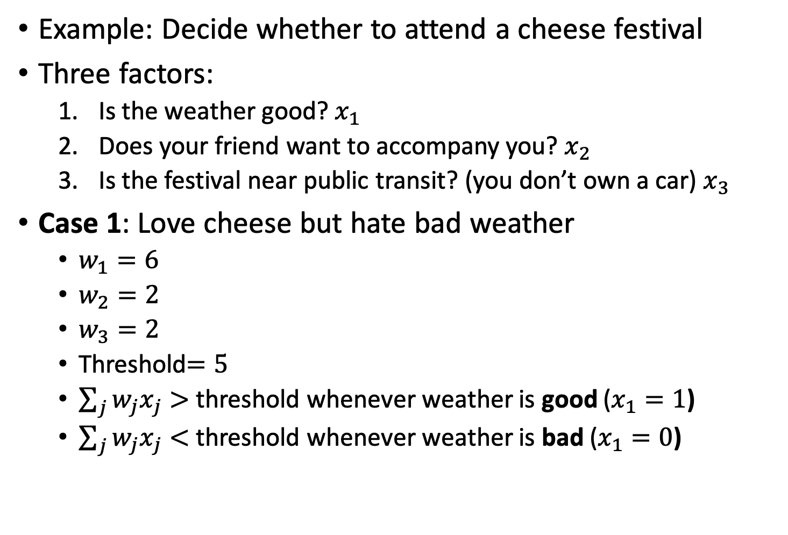
Example: Decide whether to attend a cheese festival
Three factors:
Is the weather good? $x_{1}$
Does your friend want to accompany you? $x_{2}$
Is the festival near public transit? (you don’t own a car) $x_{3}$
Case 1: Love cheese but hate bad weather
$w_{1}=6$
$w_{2}=2$
$w_{3}=2$
Threshold$=5$
$\sum_{j}{w_{j}x_{j}}>$ threshold whenever weather is good ($x_{1}=1$)
$\sum_{j}{w_{j}x_{j}}<$ threshold whenever weather is bad ($x_{1}=0$)
Notes:
The large value for w_1 indicates that the weather matters a lot more than whether bf or gf attend or nearness of public transit

Slide 29
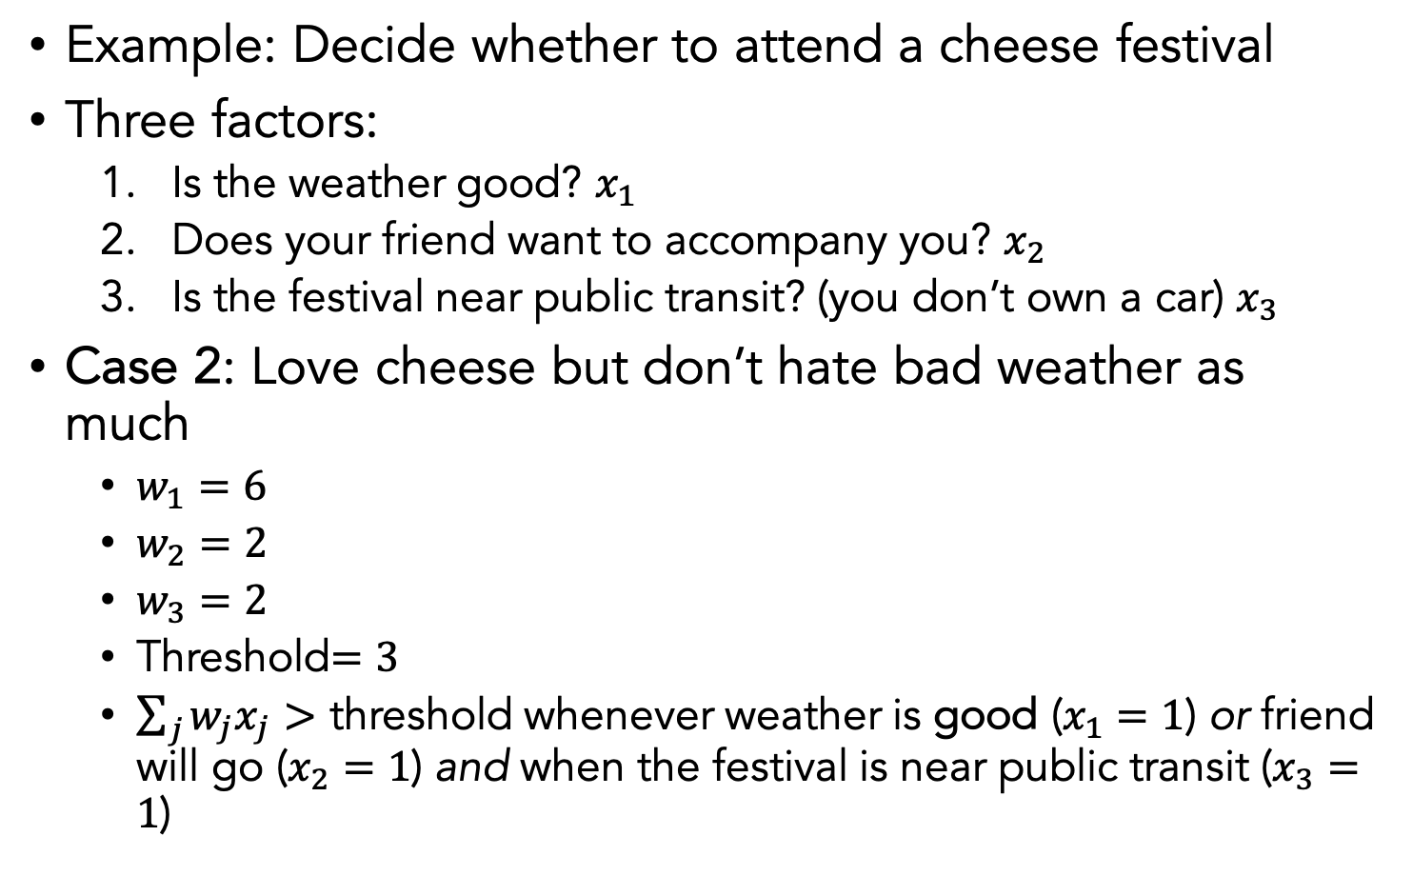
Example: Decide whether to attend a cheese festival
Three factors:
Is the weather good? $x_{1}$
Does your friend want to accompany you? $x_{2}$
Is the festival near public transit? (you don’t own a car) $x_{3}$
Case 2: Love cheese but don’t hate bad weather as much
$w_{1}=6$
$w_{2}=2$
$w_{3}=2$
Threshold$=3$
$\sum_{j}{w_{j}x_{j}}>$ threshold whenever weather is good ($x_{1}=1$) or friend will go ($x_{2}=1$) and when the festival is near public transit ($x_{3}=1$)
Notes:
Dropping the threshold means you’re more willing to go to the festival

Slide 30
Conclusions
Neural networks are collections of individual neurons or nodes that multiple input values by weights and apply a non-linearity
Layers of nodes allow for increased complexity of calculations (functions of functions)
Neural networks can theoretically approximate any function (given appropriate size)
Creative design of network architecture admits many practical applications across domains

Slide 31
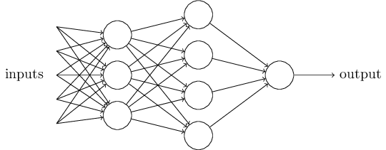
The multilayer perceptron (MLP)
A single perceptron is pretty simple
A complex network of perceptrons can make subtle decisions
First Layer
Second Layer
Nielsen, 2015
Notes:
In this network, the first column of perceptrons - what we'll call the first layer of perceptrons - is making three very simple decisions, by weighing the input evidence. What about the perceptrons in the second layer? Each of those perceptrons is making a decision by weighing up the results from the first layer of decision-making. In this way a perceptron in the second layer can make a decision at a more complex and more abstract level than perceptrons in the first layer. And even more complex decisions can be made by the perceptron in the third layer. In this way, a many-layer network of perceptrons can engage in sophisticated decision making.
Emphasize that it is the same output going to each node

Slide 32
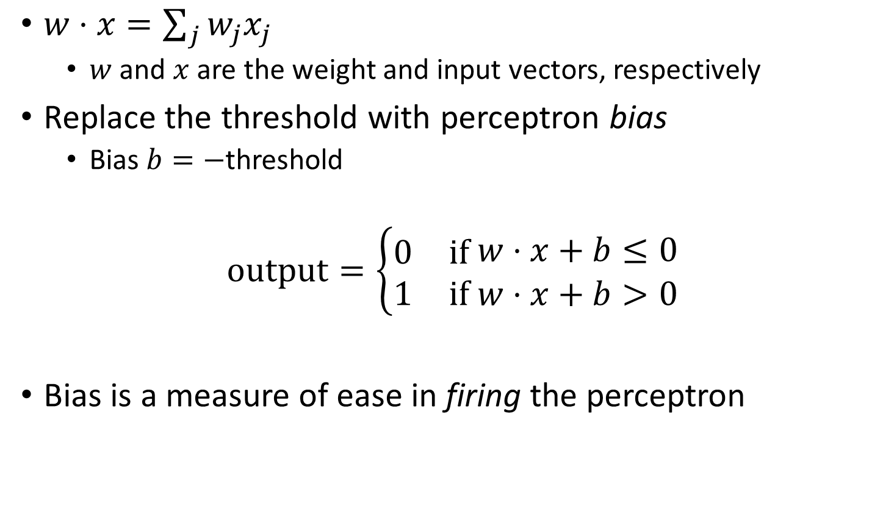
Bias
$w⋅x=\sum_{j}{w_{j}x_{j}}$
$w$ and $x$ are the weight and input vectors, respectively
Replace the threshold with perceptron bias
Bias $b=−$threshold
$$\text{output}=\left\{\begin{aligned}\begin{matrix}0 & \text{if} \end{matrix}w⋅x+b≤0 \\ \begin{matrix}1 & \text{if} w⋅x+b>0\end{matrix}\end{aligned}\right.$$
Bias is a measure of ease in firing the perceptron

Slide 33
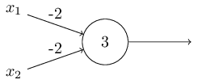
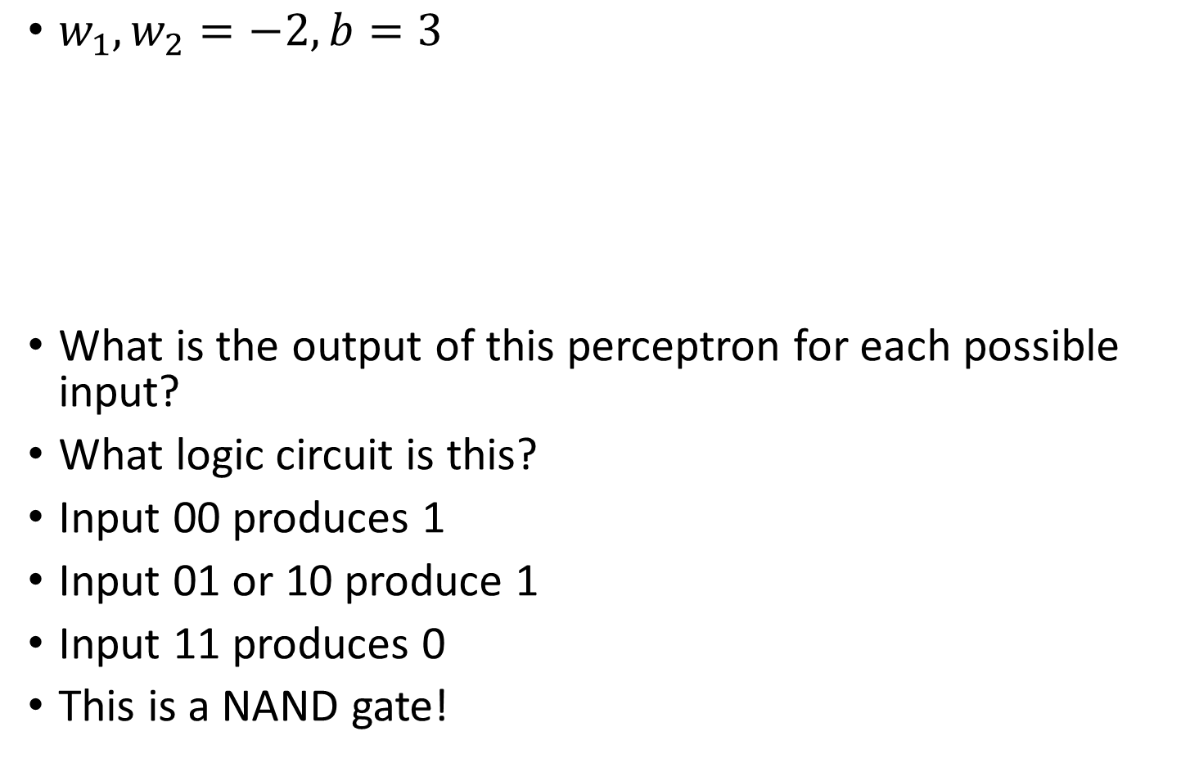
Logic circuits with perceptrons
$w_{1},w_{2}=−2, b=3$
What is the output of this perceptron for each possible input?
What logic circuit is this?
Input 00 produces 1
Input 01 or 10 produce 1
Input 11 produces 0
This is a NAND gate!
Nielsen, 2015
Notes:
Write this on the board maybe

Slide 34
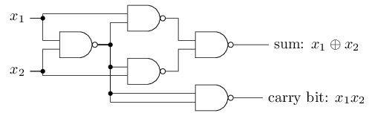
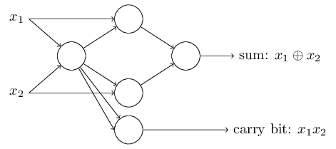
Logic circuits with perceptrons
NAND gates are universal for computation
Any computation can be built from NAND gates
Therefore, perceptrons are universal for computation
Bitwise addition:
Nielsen, 2015

Slide 35
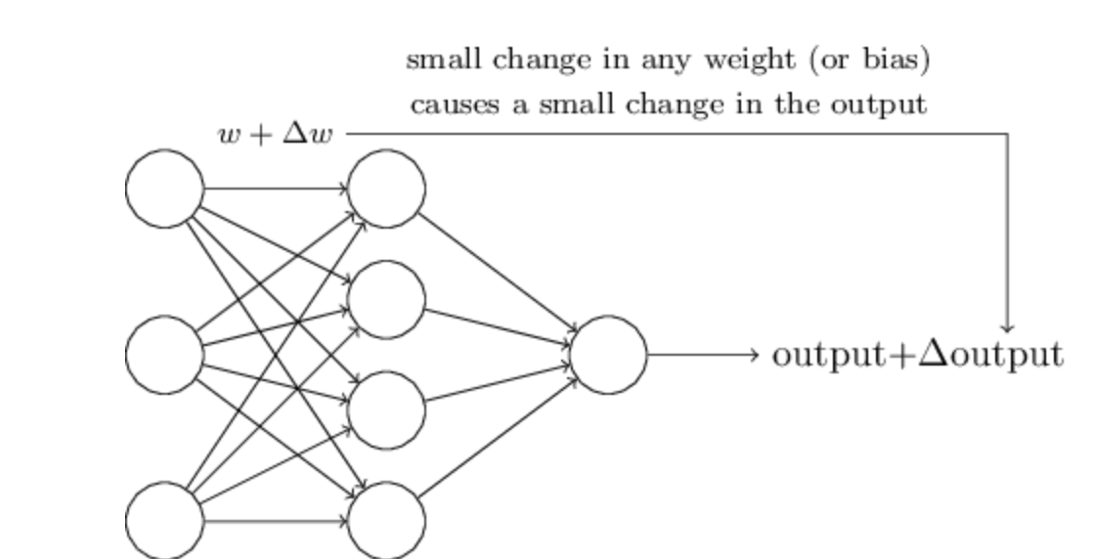
Problem with Logical Functions
Hard to “tune” in a traditional sense
Small change in weight can lead to large changes in conditions (or on change at all)
Think the volume knob in your car behaving this way
For this to happen we need neurons to perform a continuous differentiable function

Slide 36
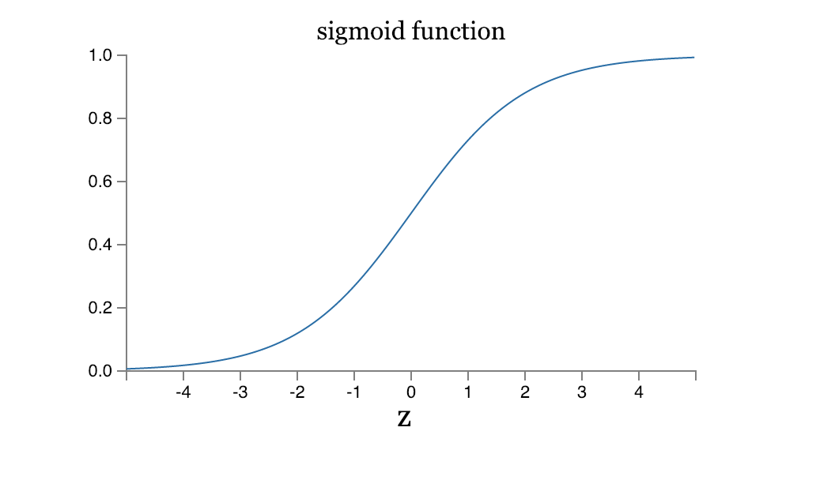
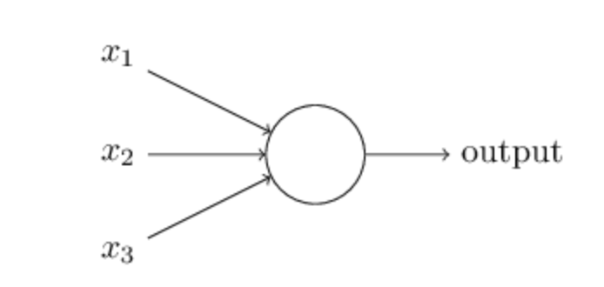
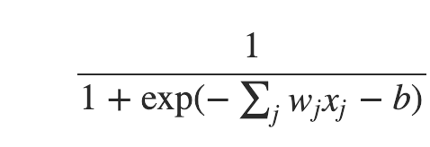
Sigmoidal Neuron

Slide 37
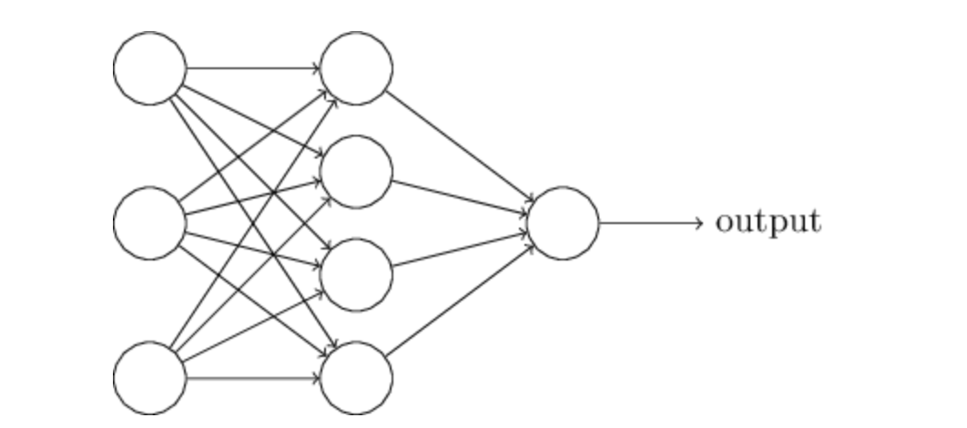
Multi-layers of Neurons

Slide 38
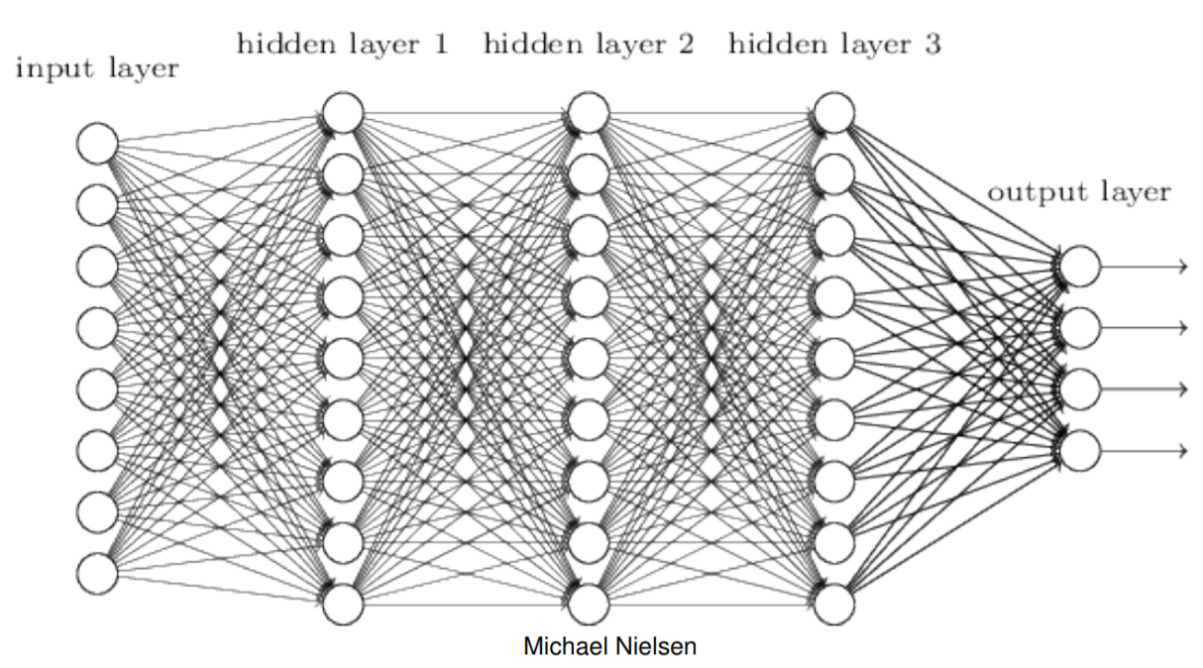
Differentiable Computing
We can create learning algorithms that automatically tune the weights and biases with Gradient Descent
Tuning occurs in response to external stimuli and w/o direct intervention
Creates a circuit designed for the problem at hand
Notes:
We already know how to make NAND gates, so this is hardly big

Slide 39
Design choices for an ANN
Activation function (e.g. threshold)
Cost functions
Number and dimension of layers
Connections between layers
Regularizations
Layers
Batches
More…
Notes:
You can imagine that we can solve a rich set of problems by various design choices. Emphasize that we can have nonlinear functions and also continuous inputs and outputs instead of binary. We will cover all of these in detail throughout the course and is a large focus of the beginning

Slide 40
Fully connected network
Every feature interacts with every other feature
Weight matrix at every level allowed to be dense

Slide 41
Training Neural Networks

Slide 42
Review: Supervised Machine Learning
Learning where there are training data with labels
Two major types of supervised learning tasks
Regression tasks
Classification tasks
Classification tasks have discrete labels
Ex: Digit type classification
Regression tasks have continuous labels
Ex: Linear regression

Slide 43
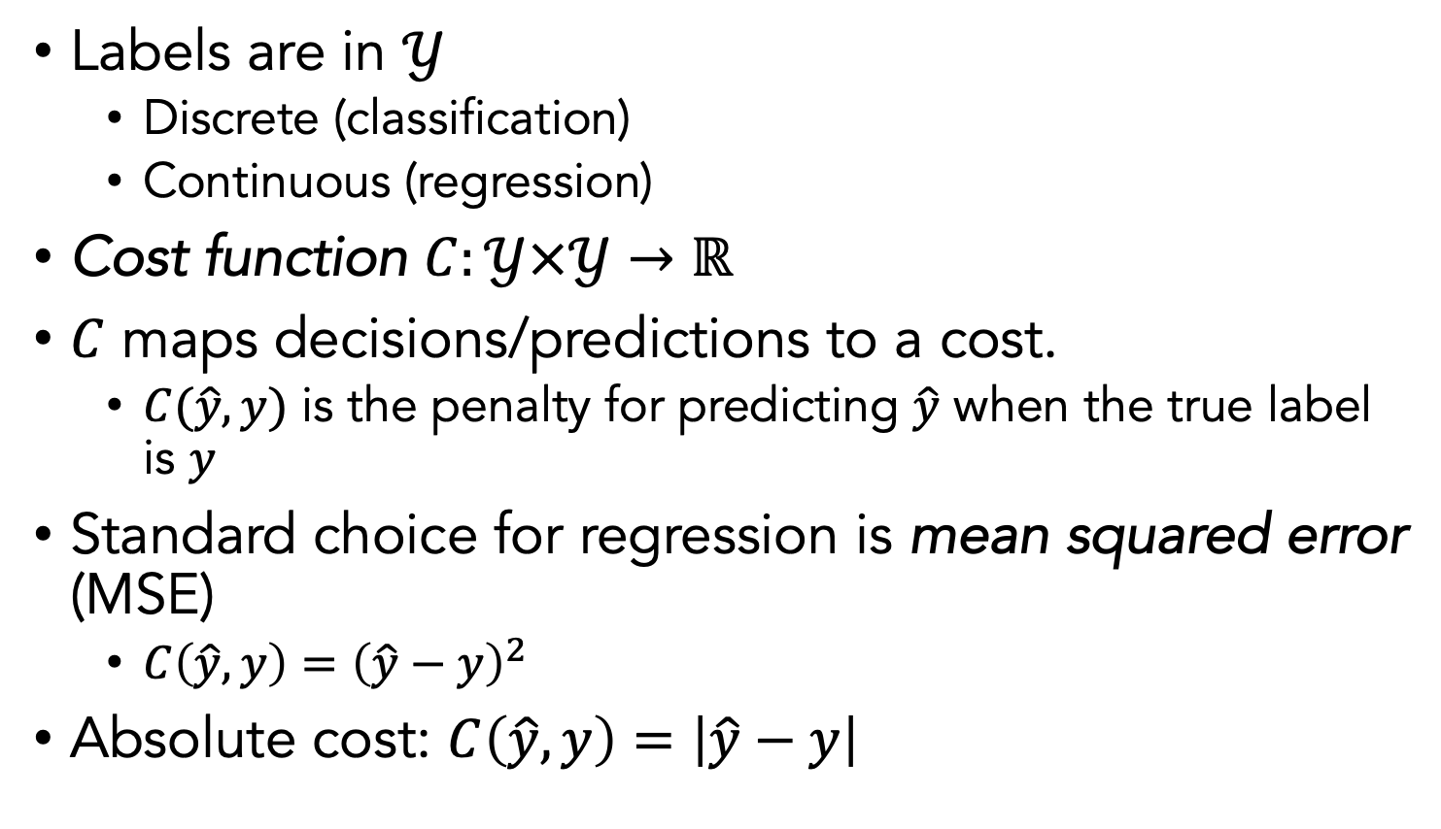
Cost functions
Labels are in $𝒴$
Discrete (classification)
Continuous (regression)
Cost function $C:𝒴×𝒴→ℝ$
$C$ maps decisions/predictions to a cost.
$C(\hat{y},y)$ is the penalty for predicting $\hat{y}$ when the true label is $y$
Standard choice for regression is mean squared error (MSE)
$C\left(\hat{y},y\right)={\left(\hat{y}−y\right)}^{2}$
Absolute cost: $C\left(\hat{y},y\right)=\left|\hat{y}−y\right|$

Slide 44
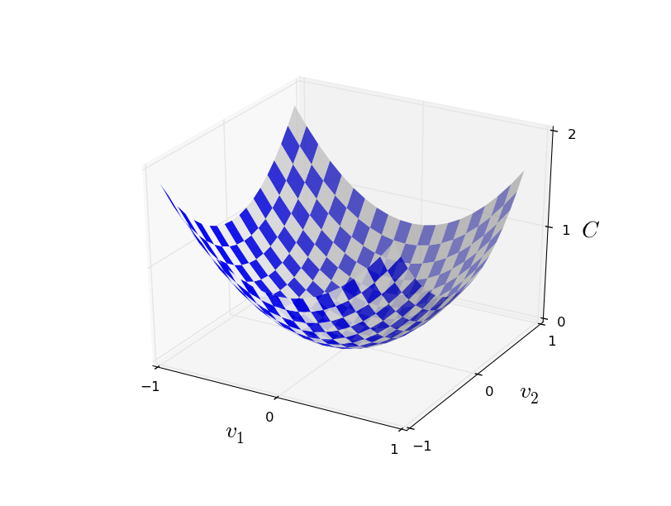
Cost/Loss Minimization
Minimum
Convex cost functions can be solved by differentiation, at the point where cost is minimum
the derivative wrt to parameters should be 0!

Slide 45
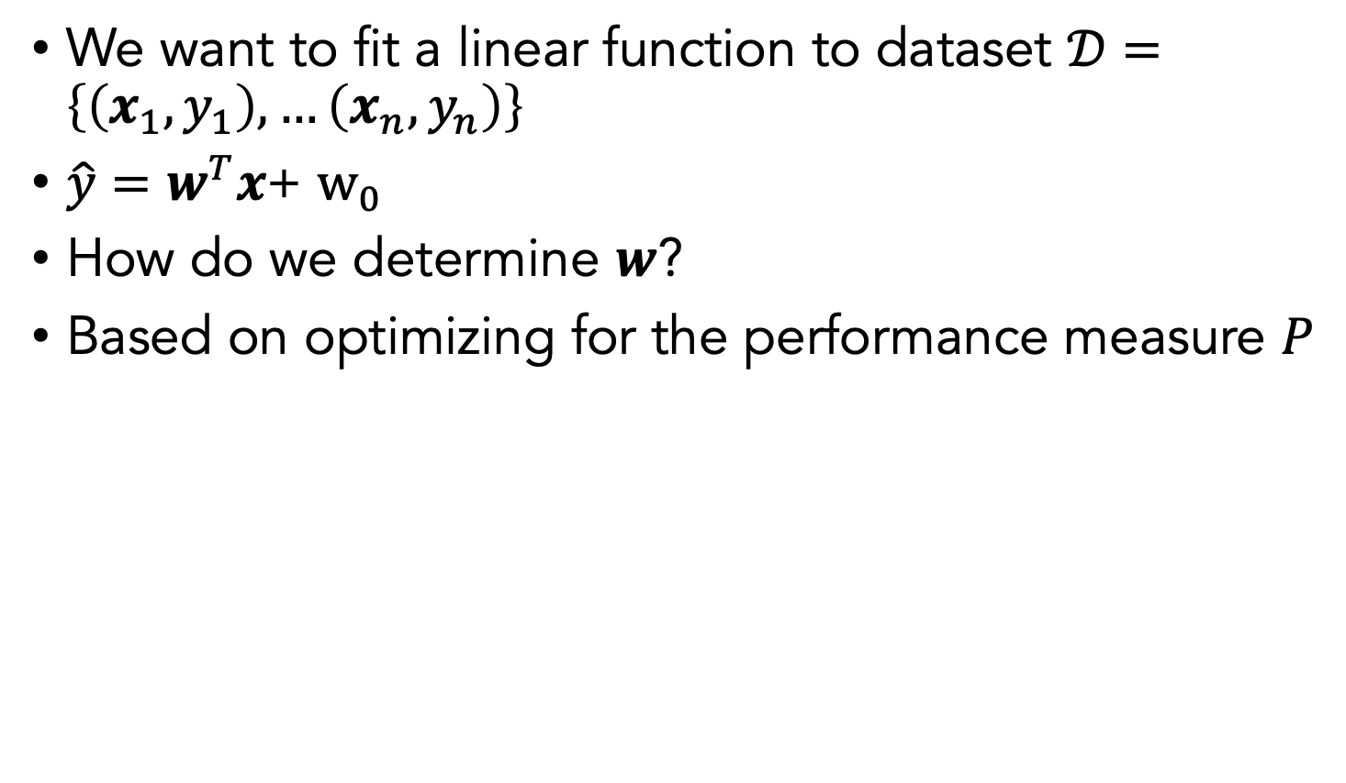
Ex: Linear Regression
We want to fit a linear function to dataset $𝒟=\left\{\left(x_{1},y_{1}\right),…\left(x_{n},y_{n}\right)\right\}$
$\hat{y}=w^{T}x$+ $w_{0}$
How do we determine $w$?
Based on optimizing for the performance measure $P$

Slide 46
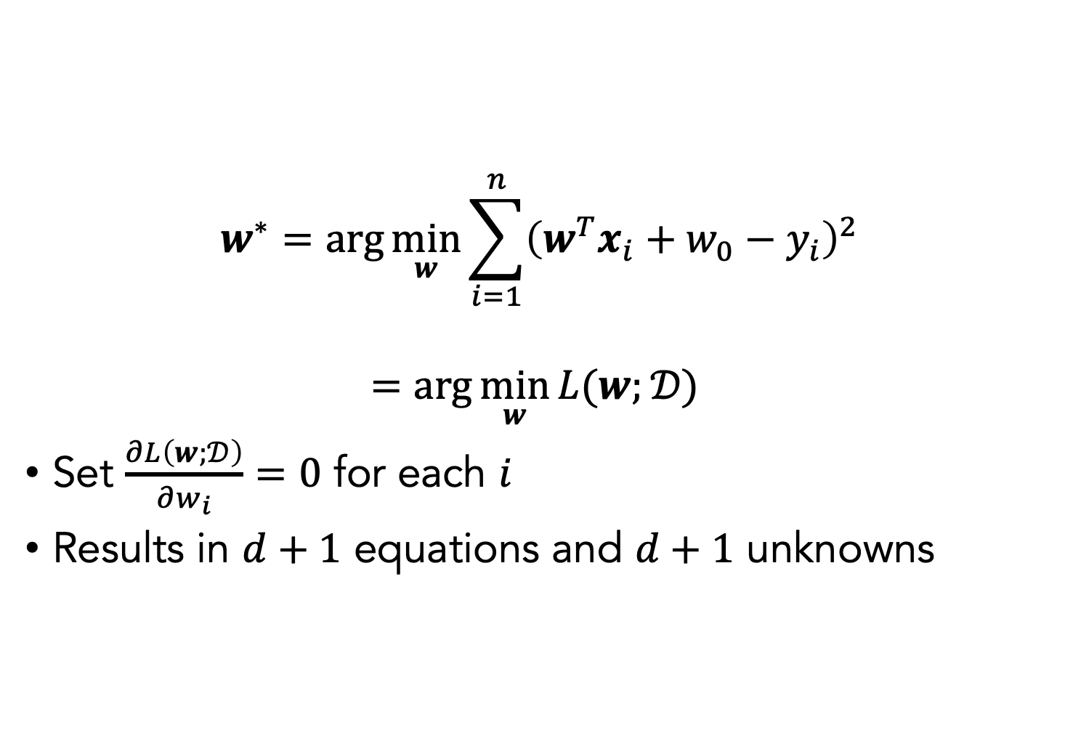
Linear Regression Optimization
$$w^{∗}=\arg{\min_{w}{\sum_{i=1}^{n}{{\left(w^{T}x_{i}+w_{0}−y_{i}\right)}^{2}}}}$$
$$=\arg{\min_{w}{L(w;}𝒟) }$$
Set $\frac{∂L\left(w;𝒟\right)}{∂w_{i}}=0$ for each $i$
Results in $d+1$ equations and $d+1$ unknowns

Slide 47
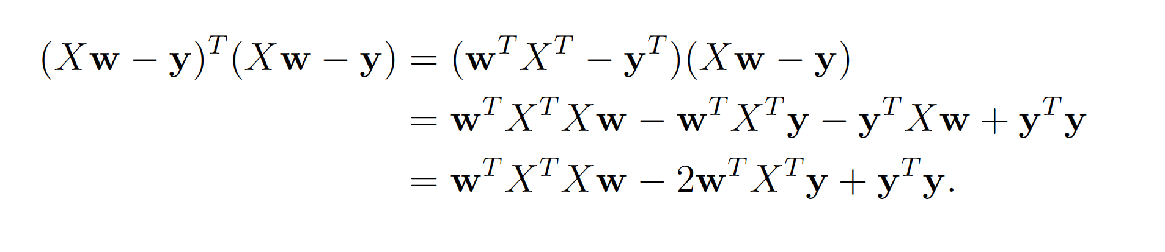
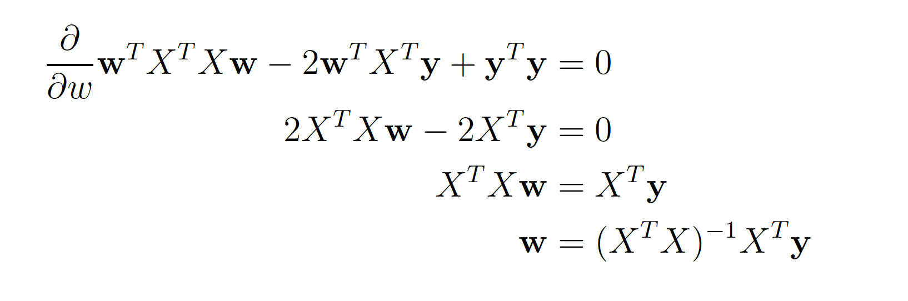

Mean squared error cost
$$w^{∗}=\arg{\min_{w}{\sum_{i=1}^{n}{{\left(w^{T}x_{i}+w_{0}−y_{i}\right)}^{2}}}}$$
Rewrite:

Slide 48
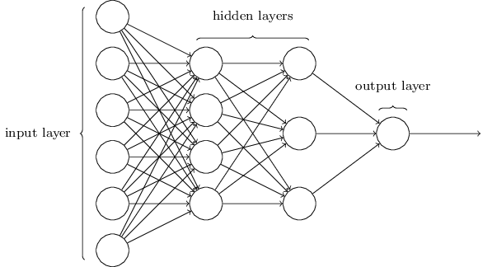
Classification/Regression Network
Sometimes called multi-layer perceptron (although sigmoid neurons are used)
Output from one layer is used as input for the next (feedforward network)
Notes:
Note that in recurrent neural networks, feedback is allowed
Note that the input layer and output layers are easily designed. Input is simply the entire size of the data input. The output will depend on the task. E.g., if we want to classify whether a digit is a 9 or not, then we have a single output neuron.
Designing the hidden layers is more difficult (and a reason why we have a whole course on this)

Slide 49
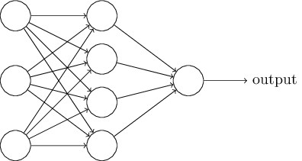

Classification with sigmoid neurons
Sigmoid neuron output $=$ any real number between 0 and 1
How do we do classification?
Threshold the final output
E.g., a value above 0.5 indicates a “9” while a value below 0.5 does not

Slide 50

Weights, bias, and output
Change in weight $Δw_{j}$, change in bias $Δb$
$$Δ\text{output}≈\sum_{j}{\frac{∂\text{output}}{∂w_{j}}}Δw_{j}+\frac{∂\text{output}}{∂b}Δb$$
$Δ$output is a linear function of the changes $Δw_{j}$ and $Δb$ in the weights and bias
Linearity makes it easier to choose small changes in weights and biases to achieve the desired small change in output
Thus sigmoid neurons have similar behavior as perceptrons but are easier to use

Slide 51

Handwritten digit recognition

Slide 52

Notes:
How would you write an algorithm for this?
https://www.polleverywhere.com/free_text_polls/1qj3UDGf5RFWsrvrLvYzF

Slide 53




Number of output neurons
Possible heuristic:
$$=$$
Notes:
Suppose these parts result in the first four neurons of the hidden layer to be fired. The more neurons we have, the more likely these kinds of shapes will correspond to specific bits.
In contrast, if we only have four output neurons, then the first output neuron would try to decide what the most significant bit of the digit was, which isn’t easy to relate to the original image. However, it is possible that there is a 4 bit solution that works better. But generally, this parts-based representation heuristic seems to work well when designing neural networks

Slide 54

A simple network
Notes:
Describe the input (28 x 28 images, greyscale). Describe output (number the neurons 0 to 9, and choose the highest value as the classification)

Slide 55

Forward Propagation
Store weights and biases as matrices
Suppose we are considering the weights from the second (hidden) layer to the third (output) layer
$w$ is the weight matrix with $w_{jk}$ the weight for the connection between the $k$th neuron in the second layer and the $j$th neuron in the third layer
$b$ is the vector of biases in the third layer
$a$ is the vector of activations (output) of the 2nd layer
$a^{′}$ the vector of activations (output) of the third layer
$$a^{′}=σ\left(wa+b\right)$$
Notes:
Note that we are applying the sigma function elementwise to every entry in the vector wa+b

Slide 56
How training works
In each epoch, randomly shuffle the training data
Partition the shuffled training data into mini-batches
For each mini-batch, apply a single step of gradient descent
Gradients are calculated via backpropagation (the next topic)
Train for multiple epochs

Slide 57


Gradient Descent
Gradient descent refers to taking a step in the direction of the gradient (partial derivative)
Gradient is the direction of steepest change
Gradient wrt weight or bias with respect to the cost function
Objective Function
$$J(Θ)$$
Initialization
configuration
Parameters
$$Θ$$

Slide 58

Gradient Descent
Gradient descent refers to taking a step in the direction of the gradient (partial derivative)
Gradient is the direction of steepest change
Gradient wrt weight or bias with respect to the cost function
$$\frac{dJ(Θ) }{dΘ}$$
Objective Function
$$J(Θ)$$
Initialization
configuration
Parameters
$$Θ$$

Slide 59
Gradient Descent
Gradient descent refers to taking a step in the direction of the gradient (partial derivative)
Gradient is the direction of steepest change
Gradient wrt weight or bias with respect to the cost function
Gradient Descent Step
Objective Function
$$J(Θ)$$
Parameters
$$Θ$$

Slide 60
Gradient Descent
Gradient descent refers to taking a step in the direction of the gradient (partial derivative)
Gradient is the direction of steepest change
Gradient wrt weight or bias with respect to the cost function
Objective Function
$$J(Θ)$$
Local minimum
Parameters
$$Θ$$

Slide 61

Gradient descent: Rolling ball analogy
Choose a random start point
Ball rolls to the bottom of the valley
Can simulate this by computing 1st and 2nd derivatives of $C$
Notes:
These derivatives tell us about the shape of the valley and how the ball should roll

Slide 62


The gradient
Choose a random starting point
Move small amounts $Δv_{1}$ in the $v_{1}$ direction and $Δv_{2}$ in the $v_{2}$ direction
$$ΔC≈\frac{∂C}{∂v_{1}}Δv_{1}+\frac{∂C}{∂v_{2}}Δv_{2}$$
The gradient of $C$ is $∇C={\left(\frac{∂C}{∂v_{1}},\frac{∂C}{∂v_{2}}\right)}^{T}$
$ΔC≈∇C⋅Δv$
Choose where $η$ is learning rate
$$Δv=−η∇C$$
Notes:
Pause here for a minute

Slide 63

Summary of gradient descent
Compute the gradient $∇C$
Move in the opposite direction
It’s like falling down the slope of the valley

Slide 64
Gradient of a sigmoidal neuron
$f\left(z\right)=\frac{1}{1+e^{−z}}$
Use chain rule with g(z) = $e^{−z}$
$\frac{δ(f\left(g(z)\right) )}{δ(z)}$=$\frac{δ(f\left(g(z)\right) )}{δ(g(z))}\frac{δ(g(z) )}{δ(z)}$
$\frac{δ(f\left(g(z)\right) )}{δ(z)}$=$\frac{e^{−z}}{{(1+e^{−z})}^{2}}$
$\frac{δ(f\left(g(z)\right) )}{δ(z)}$=$\frac{1+e^{−z}−1}{{(1+e^{−z})}^{2}}$
$\frac{δ(f\left(g(z)\right) )}{δ(z)}$=$\frac{(1+e^{−z})}{{(1+e^{−z})}^{2}}$- $\frac{1}{{(1+e^{−z})}^{2}}$
$\frac{δ(f\left(g(z)\right) )}{δ(z)}$= $\frac{1}{1+e^{−z}}$ - $\frac{1}{{(1+e^{−z})}^{2}}$
Nice form of answer is $\frac{δ(f\left(g(z)\right) )}{δ(z)}$=f(z) (1-f(z))
How do you get this in terms of weights and biases?

Slide 65

Backpropagation
Propagates gradient backward through the circuit, by using the chain rule of differentiation
f(g(x))=f’(g)g’(x) “opens out g”

Slide 66


First attempt
30 nodes in hidden layer
30 epochs
Mini-batch size $=10$
Learning rate $η=3.0$
Best accuracy at epoch 28: 95.42%
Notes:
95.42% accuracy with a relatively simple network.

Slide 67

Second attempt
100 nodes in hidden layer
30 epochs
Mini-batch size $=10$
Learning rate $η=3.0$
Improves accuracy to 96.59%
Although depends on initialization: some runs give worse results

Slide 68


Third attempt
100 nodes in hidden layer
30 epochs
Mini-batch size $=10$
Learning rate $η=0.001$

Slide 69


Debugging a neural network
What do we do if the output is essentially noise?
Suppose we ran the following as our first attempt:
30 nodes in hidden layer
30 epochs
Mini-batch size $=10$
Learning rate $η=100.0$
Notes:
What do we change?

Slide 70
Debugging a neural network
What can we do?
Should we change the learning rate?
Should we initialize differently?
Do we need more training data?
Should we change the architecture?
Should we run for more epochs?
Are the features relevant for the problem (i.e. is the Bayes error rate reasonable)?
Debugging is an art
We’ll develop good heuristics for choosing good architectures and hyper parameters

Slide 71

How well does our network do?
Need to compare to some baselines
Random guessing: 10% accuracy
Our network does much better
Simple idea: How dark is the image?
E.g. a 2 will typically be darker than a 1

Slide 72
Average darkness
Compute average darkness for each digit from the training data
Classify an image based on the digit with the closest average darkness
This gives 22.25% accuracy
Better than random guessing

Slide 73

Support Vector Machine (SVM)
Using default settings in SVM scikit-learn (a Python library) gives 94.35% accuracy
It’s possible to optimize tuning parameters to achieve 98.5% accuracy
Can neural networks do better?
Yes!
Record set in 2013 was 99.79% accuracy (only 21 wrong in the test data)
Can you do better?

Slide 74
Regularization

Slide 75

Regularization in Linear Regression
Ridge regression: penalize with L2 norm
$$w^{∗}=\arg{\min{\sum_{i}{C(f(x_{i};w),y_{i})}+λ\sum_{j=1}^{m}{w_{j}^{2}}}}$$
Closed form solution exists $w^{∗}={\left(λI+X^{T}X\right)}^{−1}X^{T}y$
LASSO regression: penalize with L1 norm
$$w^{∗}=\arg{\min{\sum_{i}{C(f(x_{i};w),y_{i})}+λ\sum_{j=1}^{m}{\left|w_{j}\right|}}}$$
No closed form solution but still convex (optimal solution can be found)

Slide 76
Regularization
In neural networks regularizations express a preference for simpler solutions
Yields an inductive bias in the solution space
Sometimes can get solution out of local minima
How do we define “simple” ?
Regularizations are not the same as in low-parameters where capacity is restricted

Slide 77

Weight decay/L2 regularization
Can write regularized cost function as
$$C=C_{0}+\frac{λ}{2n}\sum_{w}{w^{2}}$$
$C_{0}$ is the unregularized cost
First term is the cross-entropy cost function
Second term is the regularization term
Scaled by factor $\frac{λ}{2n}$, $λ$ the regularization parameter

Slide 78

Weight decay/L2 regularization
$$C=C_{0}+\frac{λ}{2n}\sum_{w}{w^{2}}$$
Regularization forces the weights to be small
Large weights allowed only if they considerably improve $C_{0}$
I.e., regularization is a compromise between finding small weights and minimizing the cost function $C_{0}$
$λ$ controls this compromise
Small $λ⇒$ we prefer to minimize $C_{0}$
Large $λ⇒$ we prefer small weights
How do we apply regularization in gradient descent?

Slide 79



L2 regularization applied to MNIST
30 hidden neurons
Train with first 1,000 training images
Cross-entropy cost
Learning rate $η=0.5$
Mini-batch size $10$
$λ=0.1$
Training cost decreases with each epoch
Test accuracy continues to increase
More epochs would likely improve results further
Regularization improves generalization in this case
Notes:
Accuracy is 87% compared to 82.27% in the unregularized case

Slide 80
Convolutions

Slide 81

Images are a series of Pixel Values
Grayscale images:
0=Black
255 = White
Spatial locality structure

Slide 82

Local receptive fields
Make connections in small, localized regions of the input image
Image taken from Michael Neilsen’s book “Neural Networks and Deep Learning”

Slide 83

Local receptive fields
Slide the local receptive field over by one (or more) pixel and repeat
Image taken from Michael Neilsen’s book “Neural Networks and Deep Learning”

Slide 84



The convolution operation
Filter/
Feature detector
Pointwise multiply
Add results
Translate filter
Image

Slide 85

Pooling
Downsampling the results by pooling values by averaging or max
Max pool is used more commonly

Slide 86

CNN Architecture
Each convolutional unit has the same weight.

Slide 87
Binding Motif Prediction
DeepBind
DeepSea

Slide 88
Autoencoders

Slide 89
Unsupervised learning
Dataset contains only features and no labels
Goal is to find hidden patterns in the unlabeled data
Examples
Density estimation
Data generation
Clustering
Data denoising
Representation learning
Semi-supervised learning attempts to combine information from both labeled and unlabeled data to deduce information
Notes:
What might this be useful for?

Slide 90
Representation learning
Find the “best” representation of the data
I.e., find a representation of the data that preserves as much information as possible while obeying some penalty or constraint that simplifies the representation
What information do we want to preserve?
How do we define simple?
Low-dimensional
Sparse
Independent components
Above criteria aren’t necessarily mutually exclusive
E.g., low-dimensional representations often have independent or weakly dependent components
Notes:
These criteria aren’t necessarily mutually exclusive

Slide 91
Representation learning
Why is a simple representation useful?
Interpretability
E.g. visualization
Computational cost
Compression
Performance
Preprocessing
Notes:
Mention that for computational cost, this can include memory and storage

Slide 92

Manifold assumption
Data may be modeled as lying on a low-dimensional manifold
Notes:
Can model the actual data as lying on a low dimensional manifold and there is some corrupting process that forces the data point off the manifold (point to the gray arrow; and then all the green arrows). From this assumption, we can often use powerful ways to learn some lower-dimensional representation of the data.

Slide 93

Autoencoder
Informational Bottleneck
Reconstruction Error
[Hinton, Salakhutdinov, Science 2006]
Notes:
Here is an example of an autoencoder. The autoencoder tries to reconstruct its input, after passing it through the layers of the network.
Notice that there is an informational bottleneck here that we’ll talk about in a second.

Slide 94

Autoencoder (AE)
Neural network trained to copy its input $x$ to its output
Hidden layer $z$ describes a code to represent the input
Two parts
Encoder: $z=f(x)$
Decoder: $x^{′}=g(z)$
Goal: minimize C$\left(x,g\left(f\left(x\right)\right)\right)$
$C$ penalizes $g\left(f\left(x\right)\right)$ for being dissimilar from $x$
Example: mean squared error
Notes:
Autoencoders are special types of neural networks that have been used to do unsupervised and semi-supervised settings
Recirculation compares activations of the network on the original input to the activations on the reconstructed input (considered more biologically plausible)

Slide 95

Are Autoencoders useful?
Can’t we just set $g\left(f\left(x\right)\right)=x$ everywhere?
Not very useful
Design the AE so it can’t learn to copy the input perfectly
Restrict the AE to copy only approximately
Can prioritize certain aspects of the input
Examples
Restrict the size of the code (i.e. add a bottleneck)
Add regularization

Slide 96

Camera Obscura
Input
Encoder
Hidden Representation
Decoder
Camera Obscura, the renaissance autoencoder
Notes:
We can use the Camera Obscura as an analogy for the autoencoder. The scenery is in the input data. The pinhole is the encoder that creates a representation of the data by projecting it. The painter is the decoder that tries to recreate the image from the encoded representation as best as possible.
The encoder and decoder are a set of layers that act as an informational bottleneck, which is achieved by various types of regularizations or the architecture of the AE.

Slide 97

Undercomplete Autoencoders
Hope: training the autoencoder will result in $z$ having useful properties
Dim$\left(z\right)<$ Dim$\left(x\right)⇒$ undercomplete autoencoder
Forces the AE to capture the most salient features of the training data
The AE only approximately copies the input (lossy compression)
Forced to learn a meaningful non-linear dimensionality reduction of the data!

Slide 98


Undercomplete Autoencoders
Special case: Linear decoder, mean squared error loss
Example: single hidden unit
What will this learn?
Minimize reconstruction error:
$$\hat{w}=\arg{\min_{w}{𝔼\left[{\left\|x−w^{T}wx\right\|}^{2}\right]}}$$
Equivalent to PCA!

Slide 99

Autoencoding MNIST
Moves to a continuous space where distances are meaningful

Slide 100

Application to Image Denoising
Compression layer automatically denoises

Slide 101

Denoising Autoencoder
Artificially add noise to input, train network to take it off

Slide 102

Uses in Single Cell
Denoising data
Visualizing data
Imputing missing data
Clustering
Batch normalization
Data generation

Slide 103

AutoEncoders in Single Cell Genomics
https://www.nature.com/articles/s41576-019-0122-6

Slide 104

Images are a specific sort of graph—grid graph

Slide 105

Graphs

Slide 106






Graph and node features
Each node v has node features
Each node v adjacent edges
Connecting to neighbors
New node features are computed like this:

Slide 107

GraphSAGE Network

Slide 108


Aggregation
1. Mean aggregation:
Neighborhood aggregation based on the mean of all nodes in the neighborhood
2. Max-pooling aggregation:
3. LSTM aggregation

Slide 109

Graph Attention

Slide 110

Spectral Graph Convolutional Networks
We can also regard features of vertices as graph signals
Can use the graph Laplacian to filter signals
Defferard et al.

Slide 111


GNNs in single cell biology
https://www.biorxiv.org/content/10.1101/2020.05.13.094953v2
https://www.biorxiv.org/content/10.1101/2020.08.02.233569v1

